Slide 1

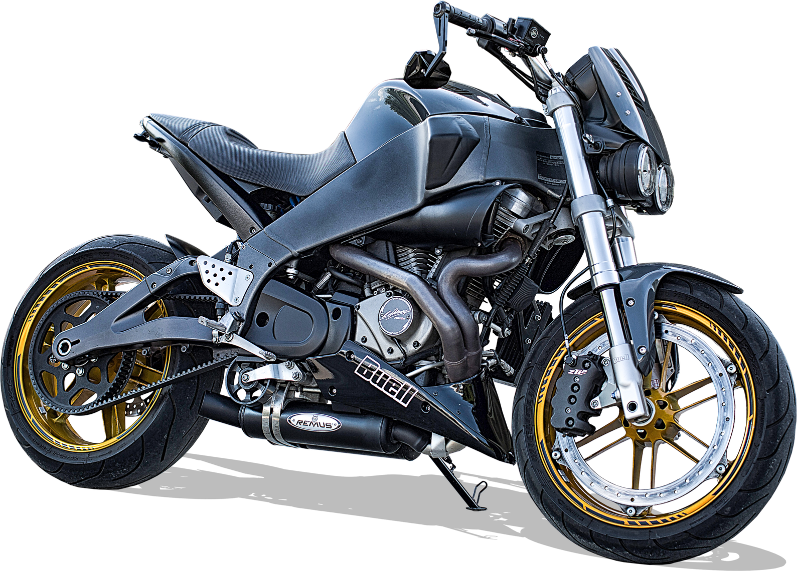


Bike dataset
Michea C.
Julian C.
Andrea M.

Slide 2

Dataset
Analysis
End
Dataset
From Kaggle, scraped from Bikez.com
~ 38'000 rows, 77 columns
02

Slide 3
Dataset
Analysis
End
What each row represents?
Each row corresponds to one motorcycle record and carries all of its attributes:
Identity & Classification
Performance & Dynamics
Engine & Drivetrain
Economy, Emissions & Features
03

Slide 4
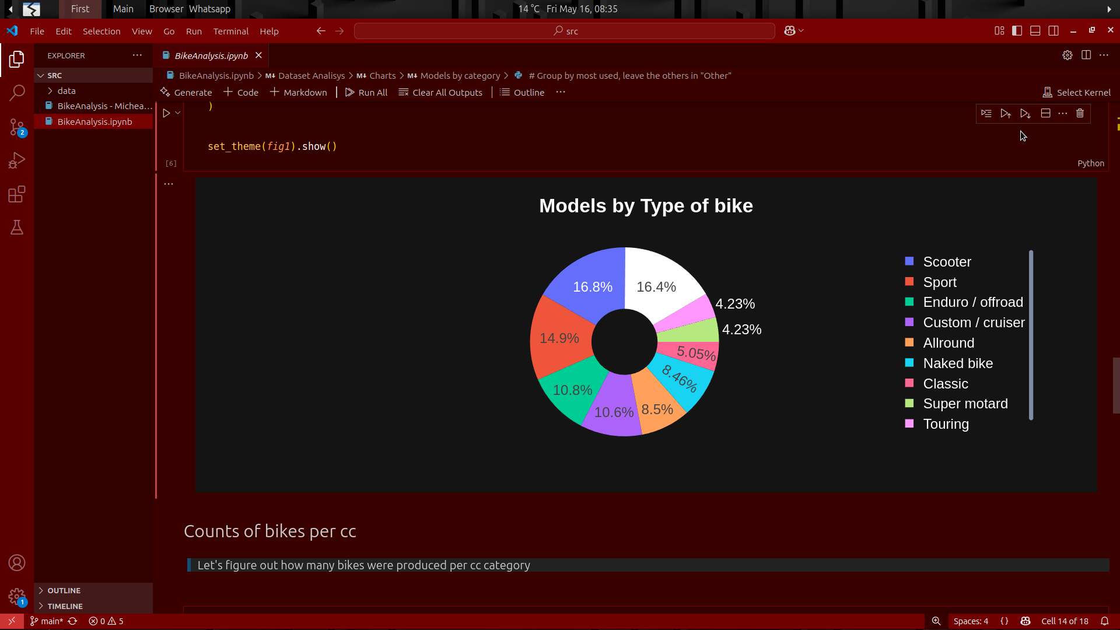
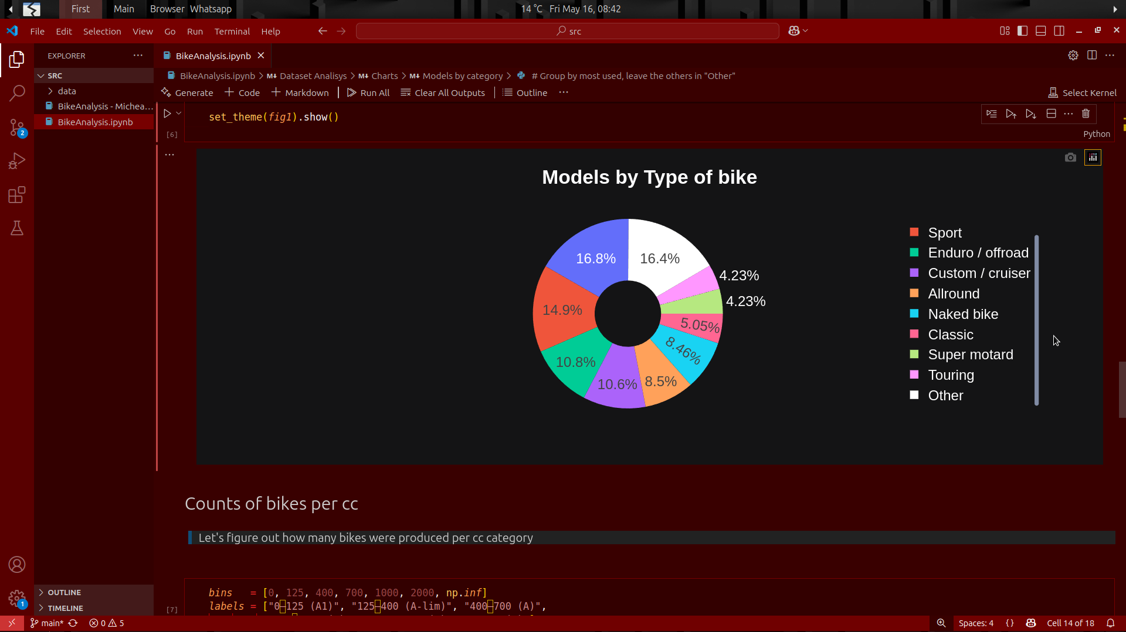
Dataset
Analysis
End
Models by type of bike
04

Slide 5
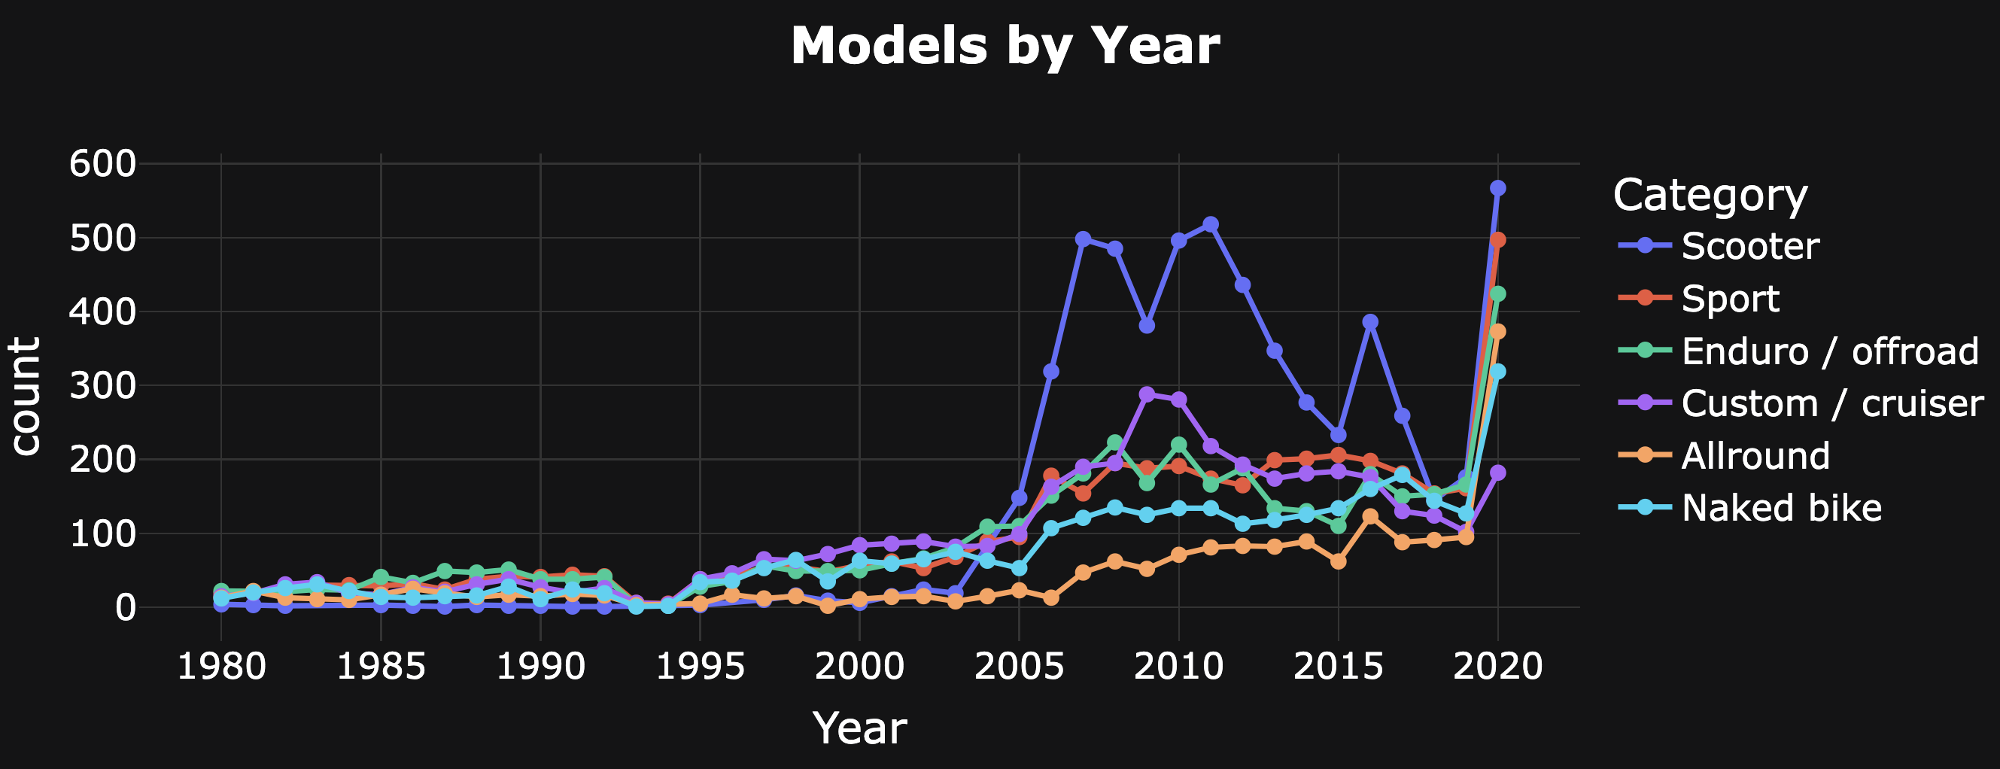
Dataset
Analysis
End
Models by Year
05

Slide 6
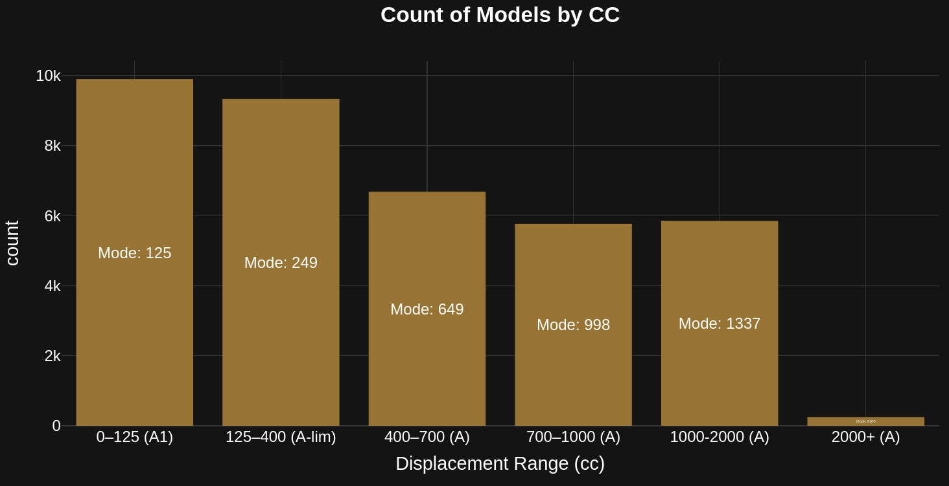
Dataset
Analysis
End
Mode: 6200
05

Slide 7
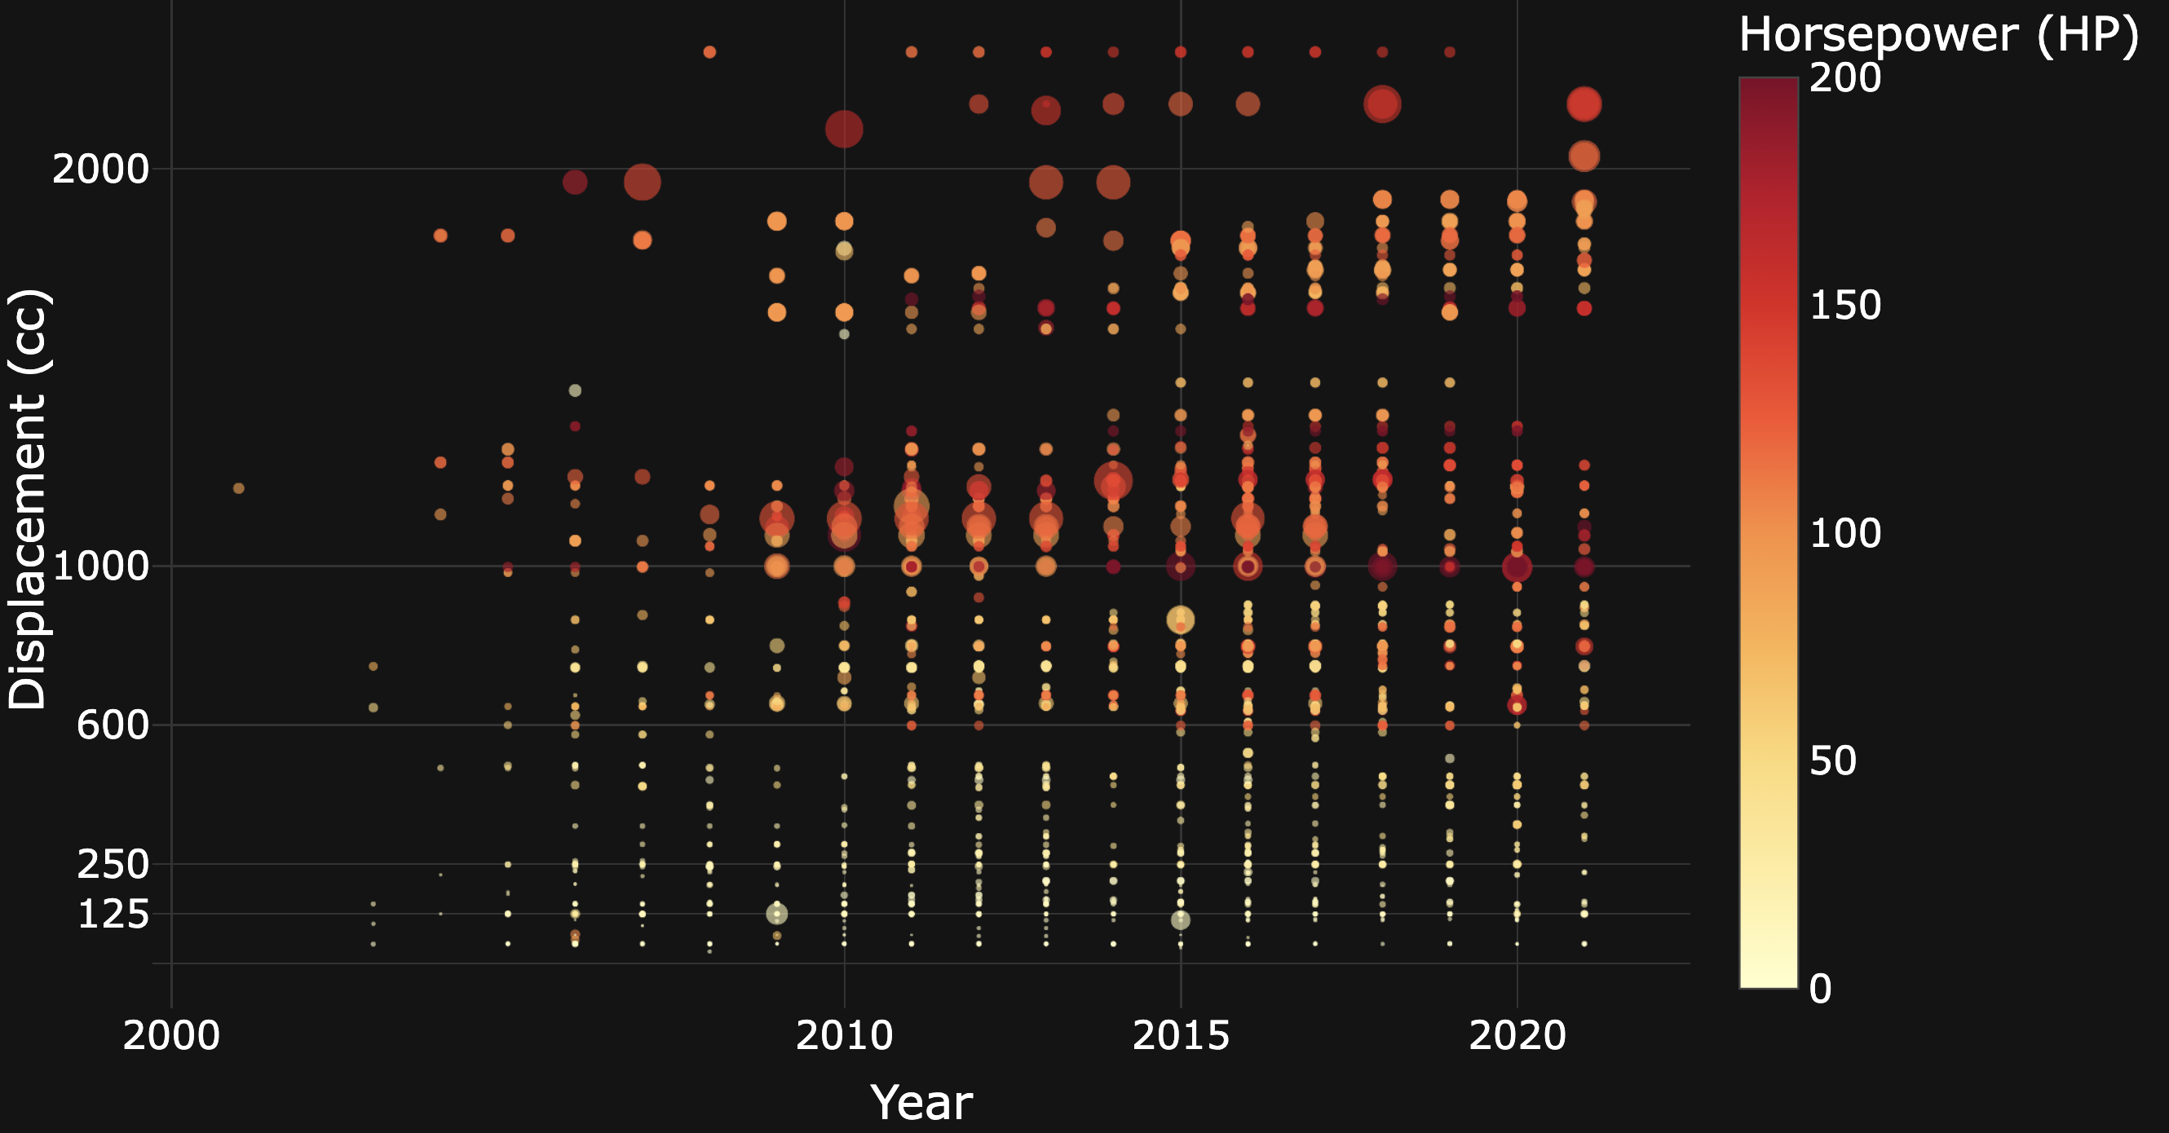
Dataset
In progress
End
Evolution of Bike HP and CC Over the Years
06
Notes:
Mic

Slide 8
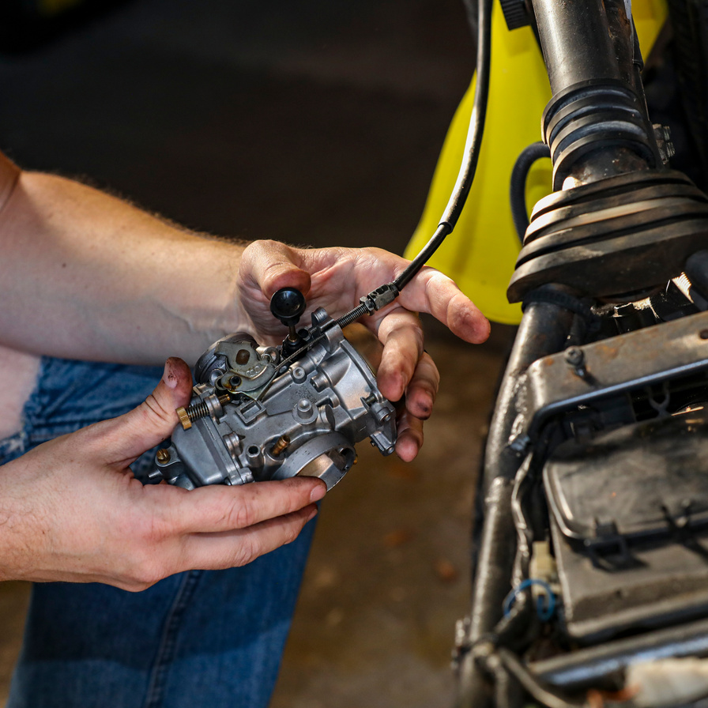

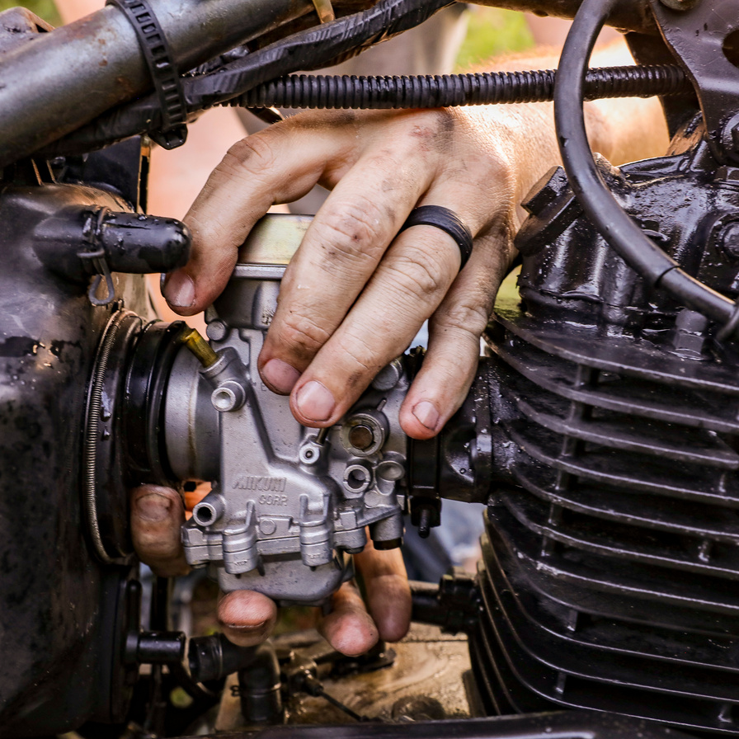
Dataset
Analysis
End
Planned analysis
Analysis on Brands grouped from models
Analysis on type of fuel and green alternative
Technical and nontechnical analysis
07

